Slide 1
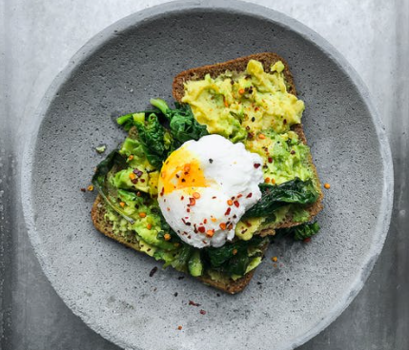
Caption text 1

Slide 2
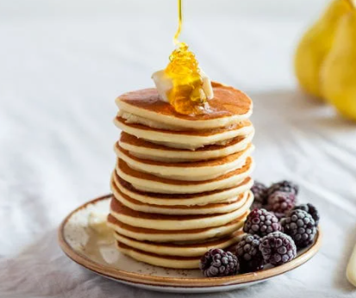
Ingredients: …
Difficulty: 3 stars
Caption text 2

